Slide 1

Power BI Graduation Project
Made by Eng/ Abdelrahman & Dr/Eman

Slide 2

Sales Performance Analysis and E-Commerce Benchmarking
In this project, I analyzed the sales performance of our industry and compared it with other e-commerce platforms. The goal is to track trends, identify growth opportunities, and recommend strategies for business improvement

Slide 3

Agenda
Problem statement
Data collection
Data analysis process
Key insights and trends
Recommendations and solutions

Slide 4

Problem
Industry Sales Gap: Our industry is facing a challenge in matching the sales performance of
leading e-commerce platforms.
Lack of Competitive Benchmarking: There’s a need to compare our sales trends with
competitors to understand where we fall behind and where we can improve.
Impact: This lack of insight is limiting our ability to make strategic decisions for growth and
efficiency improvements.

Slide 5
Data Collection & Modeling
Overview of the Dataset:
The dataset focuses on analyzing sales performance and comparing it with industry competitors to identify areas for business improvement.
Key Data Sources:
Sales Data: Monthly sales records provide detailed insight into sales trends over time.
Customer Information: Data about customer demographics and platforms helps in analyzing buying behavior.
Product Information: Product categories and segments enable a deeper understanding of sales performance by type.
Market Share: Competitive sales data allow for benchmarking against competitors in the industry.
Sales Targets: Data on yearly targets helps track how the business is performing against set goals.
Operating Expenses: Expense data such as promotions and other operational costs are considered to understand their impact on overall sales.

Slide 6

Data Modeling - Snowflake Schema
Data Model Relationships:
The sales data is the core of the analysis, with customer, product, market, and expenses data linked to provide a comprehensive view.
Fact Table: The central sales table contains the main metrics, supported by various dimension tables to allow filtering by customer, product, market, and competitor data.
Performance Comparison: Data on competitors and sales targets are linked to track performance and offer actionable insights.

Slide 7
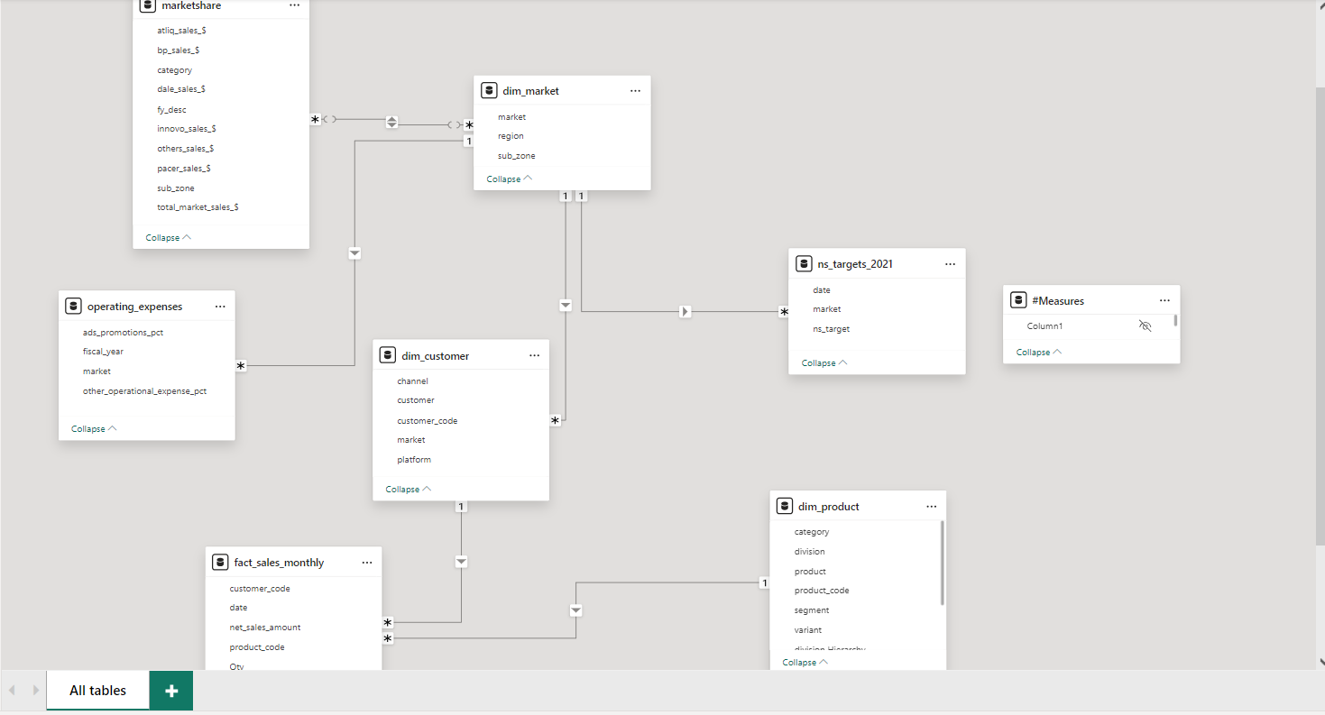

Slide 8

Data Cleaning & Preparation
Data Cleaning Approach:
To ensure the data is ready for analysis, several key data cleaning and preparation steps were performed using Power Query in Power BI:
Promoting Headers: The data was organized by promoting the first row of each table to headers, ensuring that the columns were labeled correctly for further analysis.
Changing Data Types: Correct data types were assigned to each column, such as converting text fields, numbers, and dates into the appropriate format. This step ensured that data was treated correctly during calculations and visualizations.
Removing Duplicates: Duplicate records that could skew the results were identified and removed, ensuring the data was clean and accurate.
Handling Missing Data: Missing or incomplete values were either filled, replaced, or removed to maintain the integrity of the dataset.

Slide 9

DAX Calculations
For this project, several essential calculations were created using DAX (Data Analysis Expressions) in Power BI. These measures provided critical insights into the sales performance and operational efficiency of the business:
Net Sales: Total revenue generated from sales.
Target Sales: A measure to track performance against the business’s sales targets.
Profit: A calculation that evaluates profitability by subtracting expenses from net sales.
Average Operating Expenses: The average of operating expenses across different markets, used to assess cost-efficiency.
Total Quantity: Total number of products sold, giving insight into sales volume.
Number of Customers: Count of unique customers, helping track the size and growth of the customer base.

Slide 10
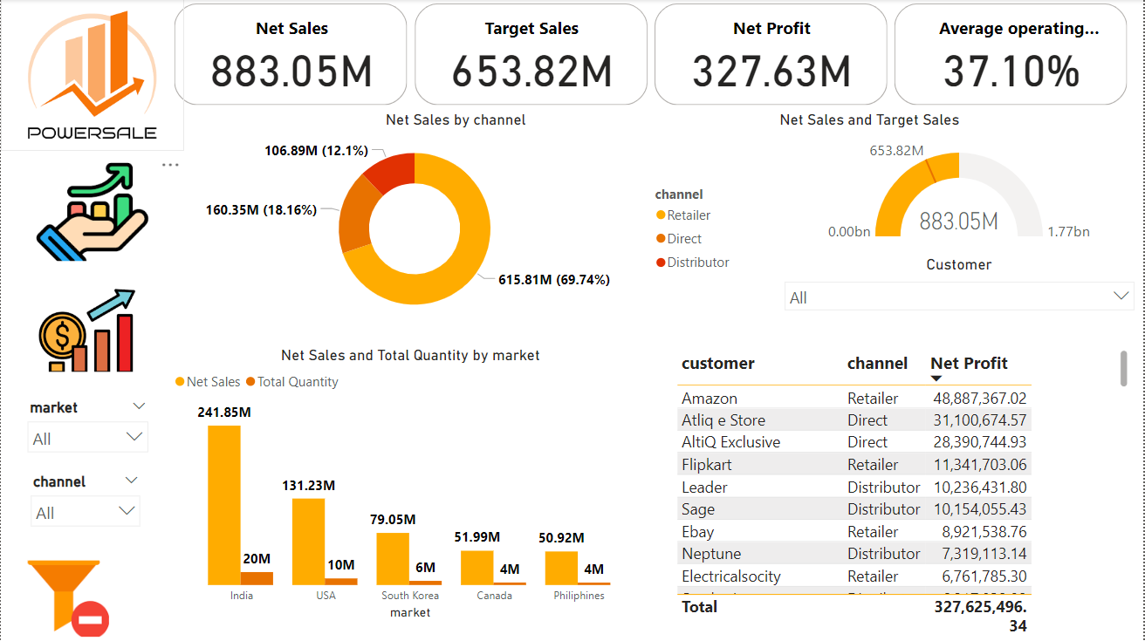
Power BI Service Link

Slide 11
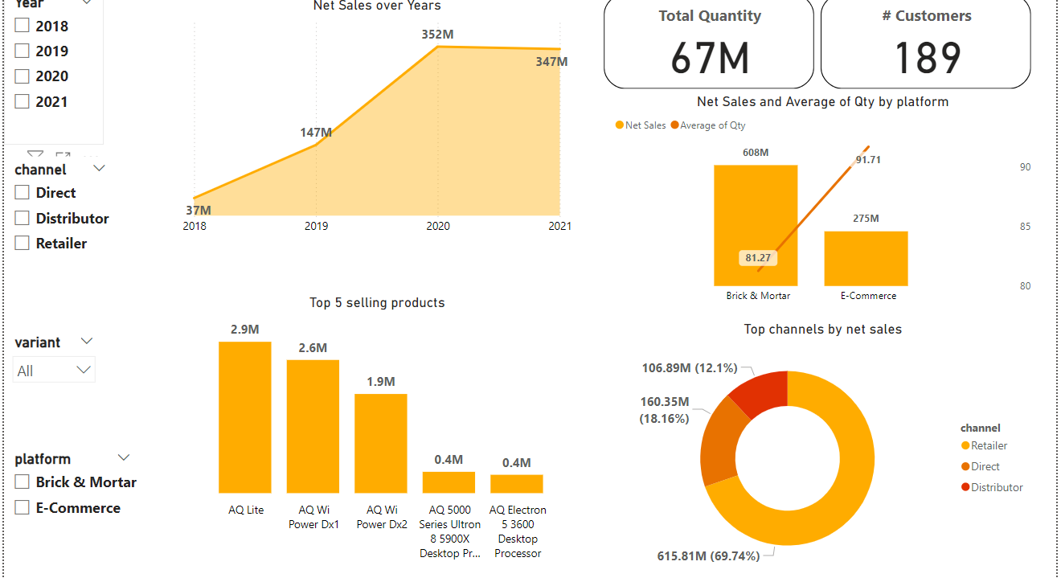

Slide 12
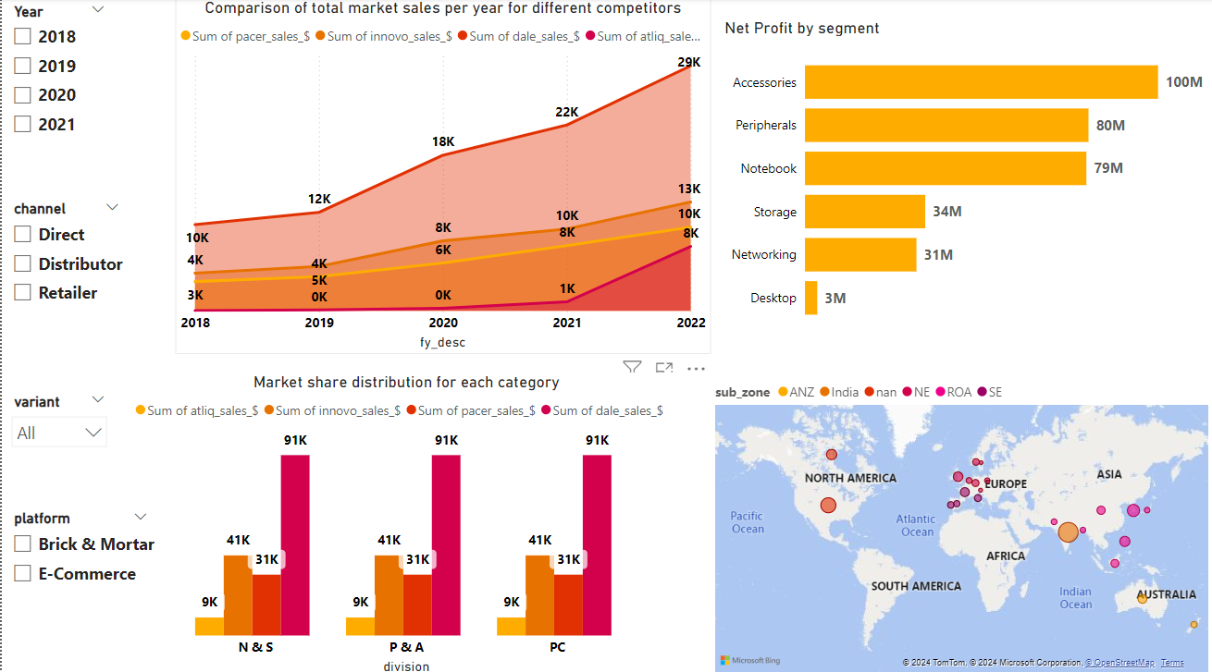

Slide 13
Recommendations:
Channel Optimization: Given that the Retailer channel accounts for 69.74% of net sales, consider:
Analyze what makes the retail channel successful and apply insights to other channels
Investigate ways to boost Direct (18.16%) and Distributor (12.1%) channels:
-For Direct: Enhance e-commerce platforms, improve user experience
-For Distributor: Offer incentives, provide better support and training
Product Focus: Concentrate on high-performing products like AQ Lite, AQ Wi Power Dx1, and AQ Wi Power Dx2. Consider:
Increasing production and inventory for these products
Investing in marketing and promotions for these top sellers
Analyzing the features that make these products successful and applying them to other product lines

Slide 14
E-Commerce Growth: Given the higher average quantity (91.71) for e-commerce compared to brick & mortar (81.27):
Develop targeted online marketing campaigns
Consider offering e-commerce exclusive deals or products
Invest in improving the e-commerce platform and user experience
Market Expansion: With India and USA being the top markets, consider:
Deepening market penetration in these countries
Exploring growth opportunities in emerging markets like South Korea, Canada, and Philippines
Tailoring product offerings and marketing strategies to each market's specific needs and preferences

